Slide 2
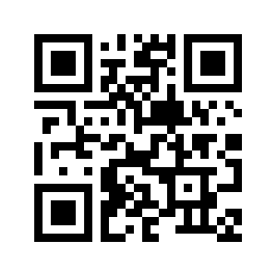
Welcome to the UN-Women
Transparency Portal user guide
About this user guide
Content of this user guide
This guide will assist users in exploring the Transparency Portal.
The Transparency Portal is an interactive and data-driven public platform that makes UN-Women’s results and resources data visible to partners and the general public. The published data is in line with the International Aid Transparency Initiative (IATI) standard.
This guide specifically focuses in greater detail on the “Our Global Results” section as an official annex to the Executive Director’s Annual Report, reporting on UN-Women’s Strategic Plan 2022-2025.
Link to the Transparency Portal – https://open.unwomen.org/
System requirements – we suggest using updated Microsoft search engine or Google chrome and its newer versions.
Overview
How to find data of the Strategic Plan’s Integrated Results and Resources Framework (SP IRRF)
Other sections of the Transparency Portal

Slide 4
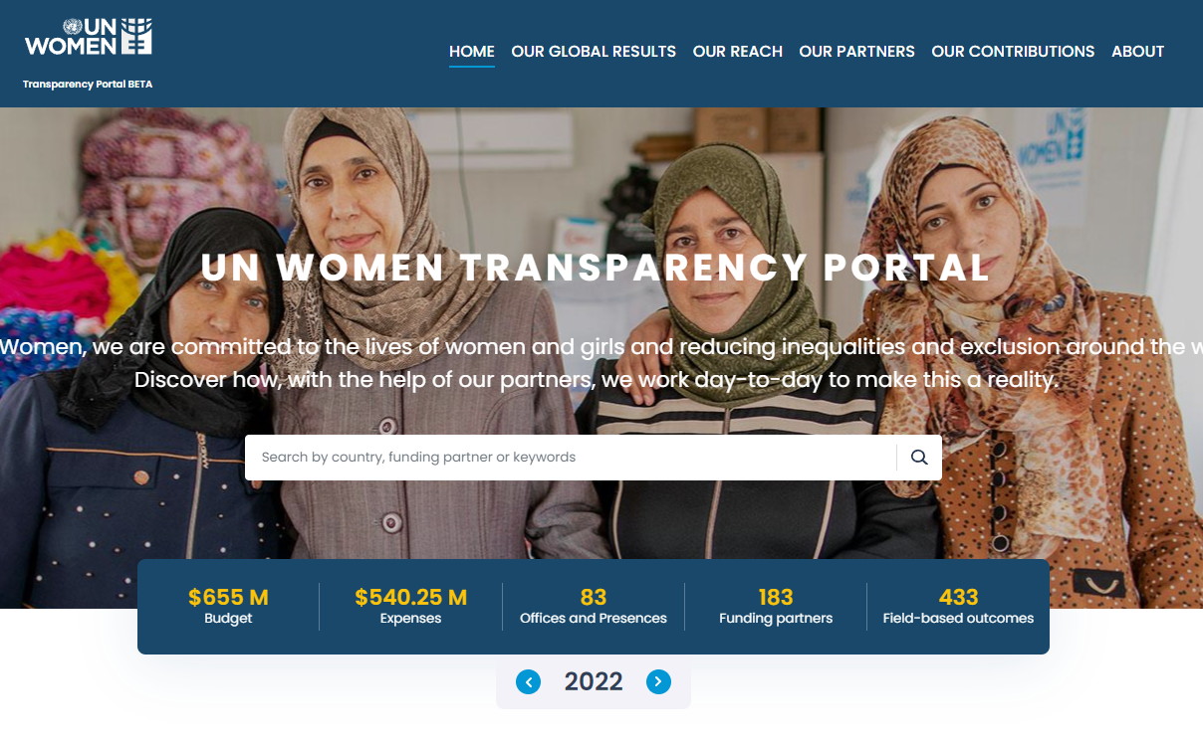
What information can be found on the Transparency Portal?
Global results from UN-Women’s Strategic Plans, including indicator data, key results and revenue and expenses data. This section is an official annex to the Executive Director’s Annual Report
UN-Women’s field-based results and resources data against Strategic Notes
UN-Women’s funding partner contributions.
UN-Women’s contributions to the Sustainable Development Goals and ‘Leaving No One Behind’

Slide 5
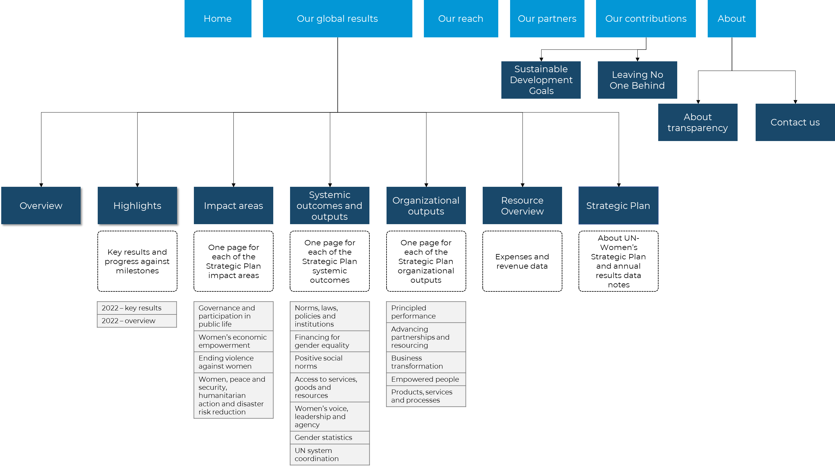
How is the content of the Transparency Portal organized?

Slide 6
II: HOW TO FIND DATA OF THE STRATEGIC PLAN’S INTEGRATED RESULTS AND RESOURCES FRAMEWORK (SP IRRF)
ANNEX OF THE UN-WOMEN EXECUTIVE DIRECTOR’S ANNUAL REPORT

Slide 7
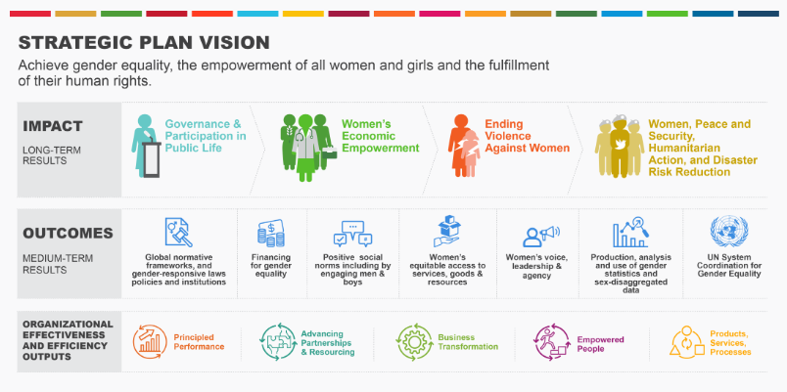
How is the content of the “Our global results” section organized?
View overall key results and progress against milestones
4 thematic impact areas
7 systemic outcomes
5 organizational outputs
Explore UN-Women’s financial data in terms of expenses and revenue by regular resource (core), other resources (non-core) and assessed contributions
UN-Women’s Strategic Plan 2022-2025 and annual results data notes
Link - https://open.unwomen.org/global-results

Slide 8
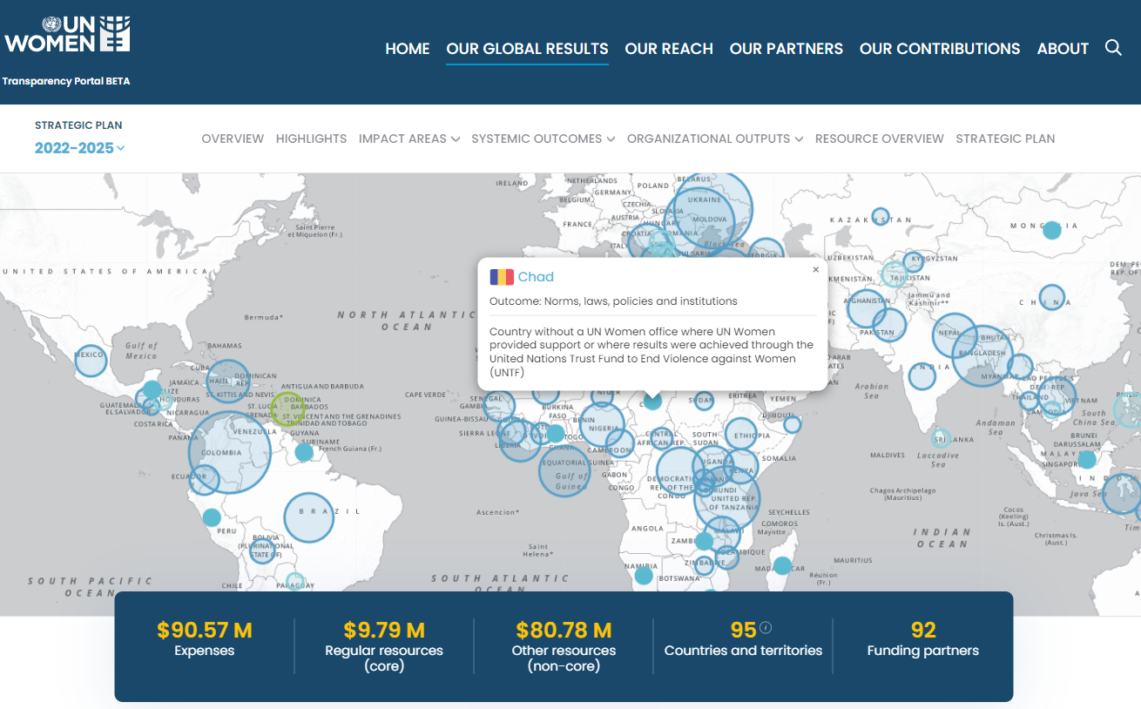
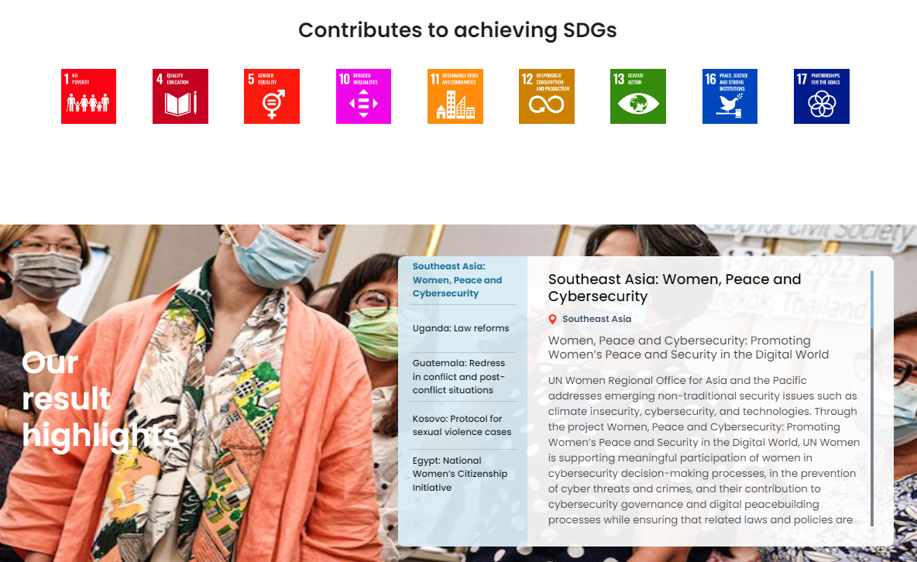
What information can be found on the pages per impact area, systemic outcome and organizational output?
On the map, users can view the countries contributing to results including expenses and funding partners for a respective impact, outcome or output.
Further, the pages show result highlights, key achievements (only for systemic outcome pages), financial flows (only for impact area and systemic outcome pages) and data against the indicators of the UN-Women Strategic Plan Integrated Results and Resources Framework (SP IRRF).
Link (example of a systemic outcome page) -
https://open.unwomen.org/our-global-results/sp-outcomes/SP_D_0.1/2022-2025

Slide 9
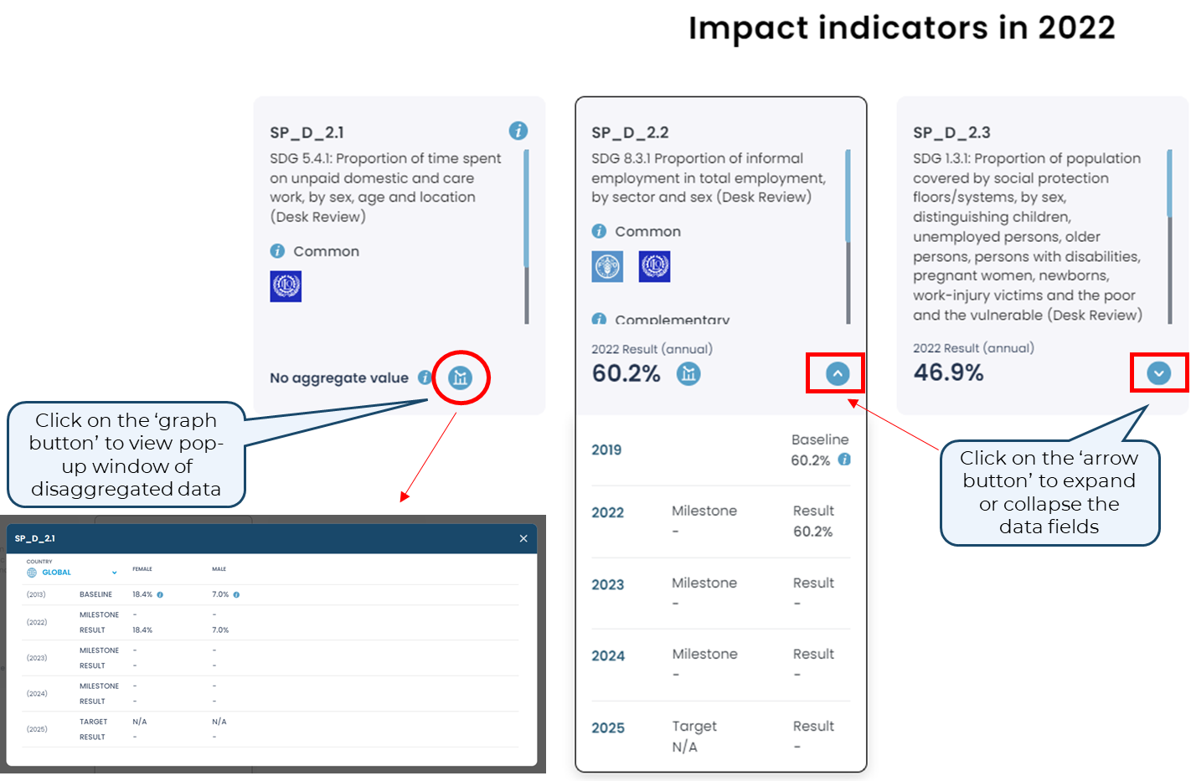
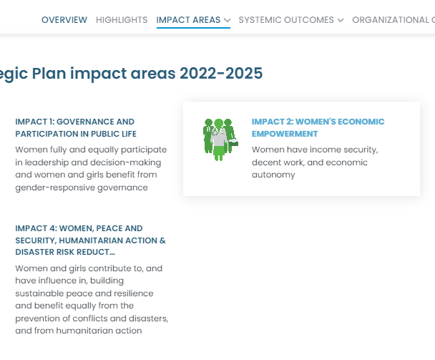
How to find data against impact indicators of the SP IRRF?
Users can view and download indicators (including baselines, targets and results) for each impact area by following the steps below.
Step 2
Step 1
Scroll to the bottom of the page
How to download the data?
Find ‘download’ option below the data set
Link (example of an impact area page) -
https://open.unwomen.org/our-global-results/sp-impact/SP_D_2/2022-2025

Slide 10
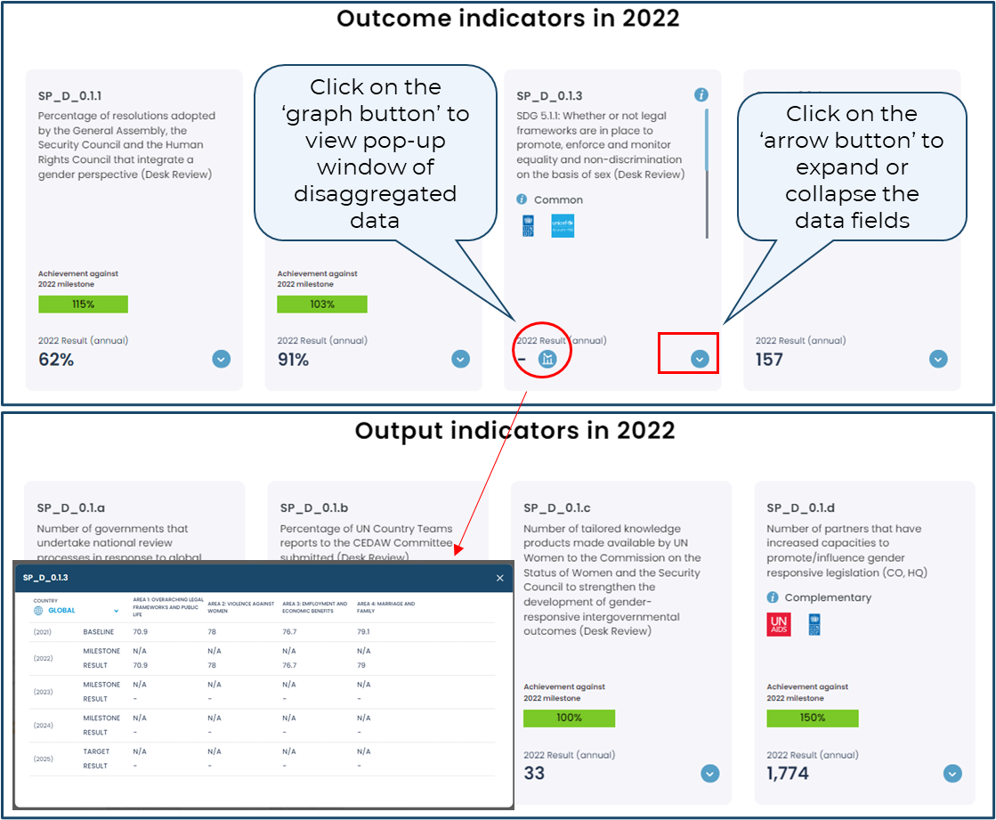
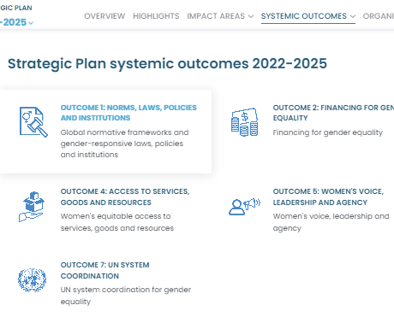
How to find data against outcome and output indicators of the SP IRRF?
Users can view and download indicators (including baselines, milestones, targets and results) for each systemic outcome and output by following the steps below.
Step 2
Step 1
Scroll to the bottom of the page
How to download the data?
Find ‘download’ option below the data set
Link (example of a systemic outcome page) -
https://open.unwomen.org/our-global-results/sp-outcomes/SP_D_0.1/2022-2025

Slide 11
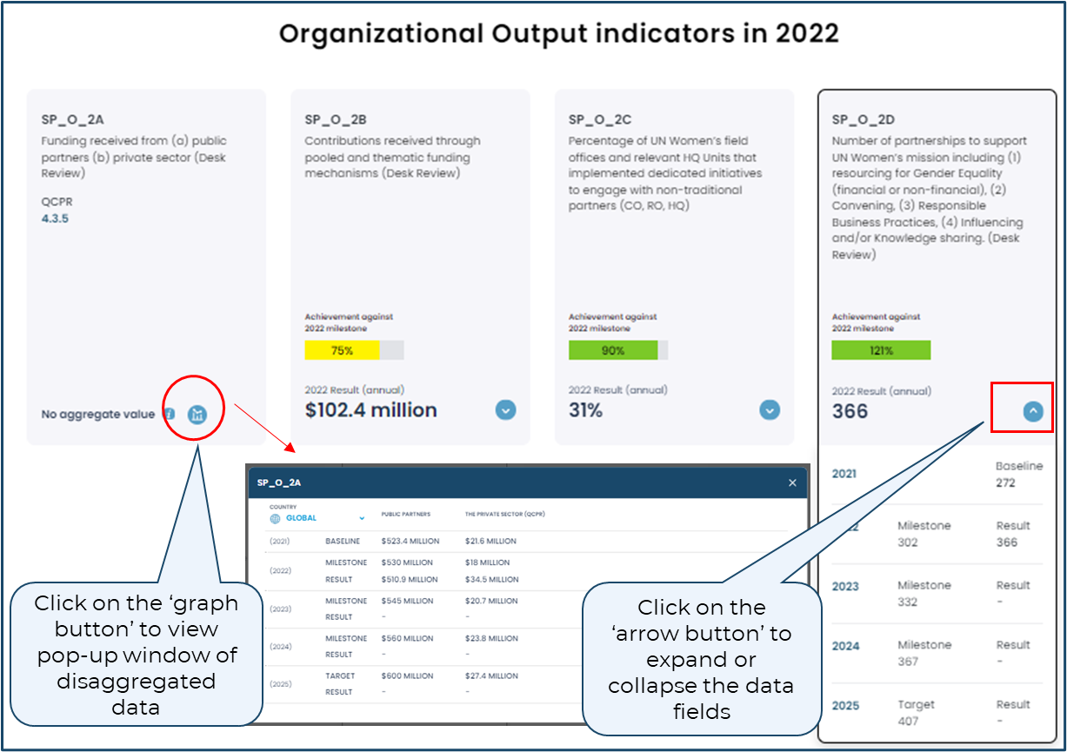
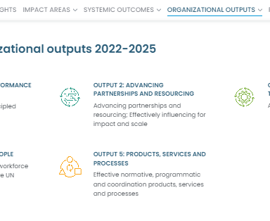
How to find data against organizational output indicators of the SP IRRF?
Users can view and download indicators (including baselines, milestones, targets and results) for each organizational output by following the steps below.
Step 2
Step 1
Scroll to the bottom of the page
How to download the data?
Find ‘download’ option below the data set
Link (example of an organizational output page) -
https://open.unwomen.org/our-global-results/sp-oee-output/SP_O_1/2022-2025

Slide 12
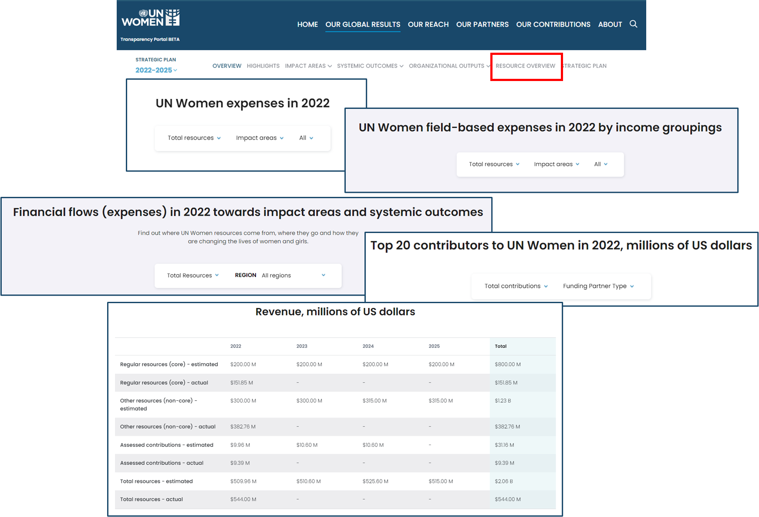
Explore ‘Resource overview’: UN-Women’s expenses and revenue data
Users can select different combinations of filter options in the charts included on this page.
These include, for example regular resources (core), other resources (non-core) and assessed contributions, as well as impact areas, systemic outcomes and organizational outputs or by region.
Link - https://open.unwomen.org/our-global-results/resource-overview/2022-2025

Slide 13
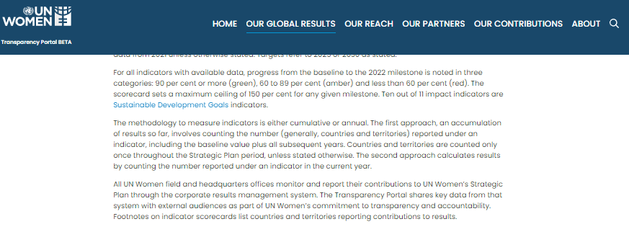
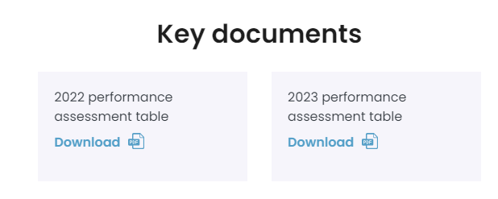
Access the key document of performance assessment per Strategic Plan outcome and output indicators milestone
Users can access the key document, which contains information about performance assessments based on Strategic Plan outcome and output indicators. It provides a summary of progress, average progress towards the milestone, and results.
Scroll to the bottom of the page and click on ‘Download’
Link - https://open.unwomen.org/our-global-results/strategic-plan/2022-2025

Slide 15
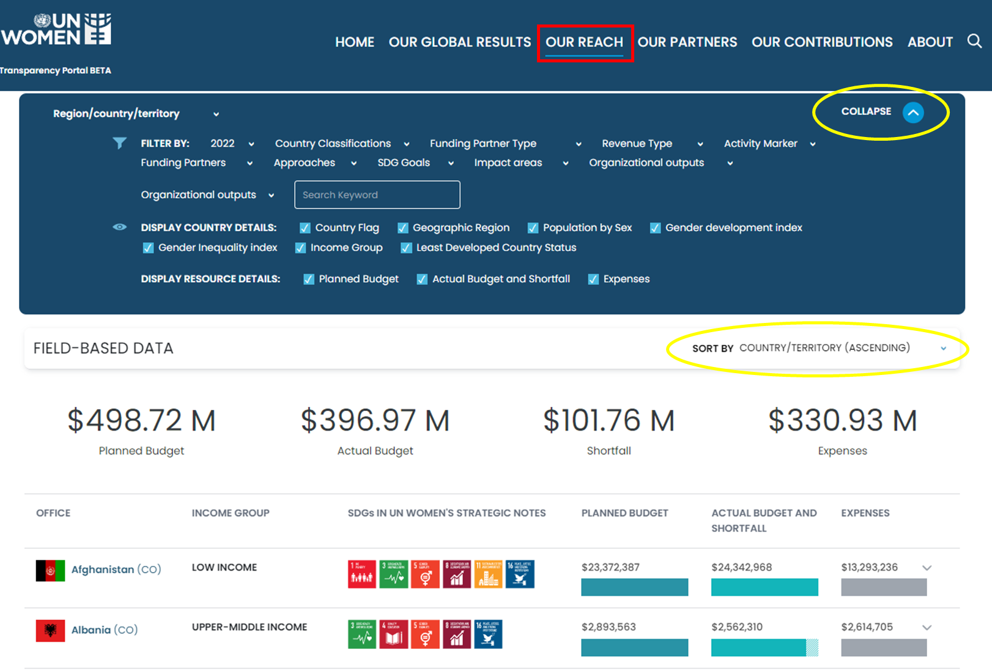
Explore ‘Our reach’: Results and resources data against UN-Women’s Strategic Notes
Users can apply different filter and sort options to compare the various UN-Women’s offices.
By clicking on a specific country, users can see financial and indicator data as well as progress narratives per Strategic Note outcome.
Link - https://open.unwomen.org/our-reach

Slide 16
Explore ‘Our partners’: Financial contributions data by UN-Women’s funding partners
The racing bar chart shows the total contributions of UN-Women’s top 10 funding partners from 2014 to present (see expand and collapse button in green circles).
Funding partners and contributions can be filtered (in yellow box) by year, partner type, revenue type, contributions amount.
To view which outcomes a specific funding partner contributes to, users can click on a specific funding partner.
All mentioned data can be viewed and downloaded (find ‘download’ button at the bottom of the webpage).
Link - https://open.unwomen.org/partners

Slide 17
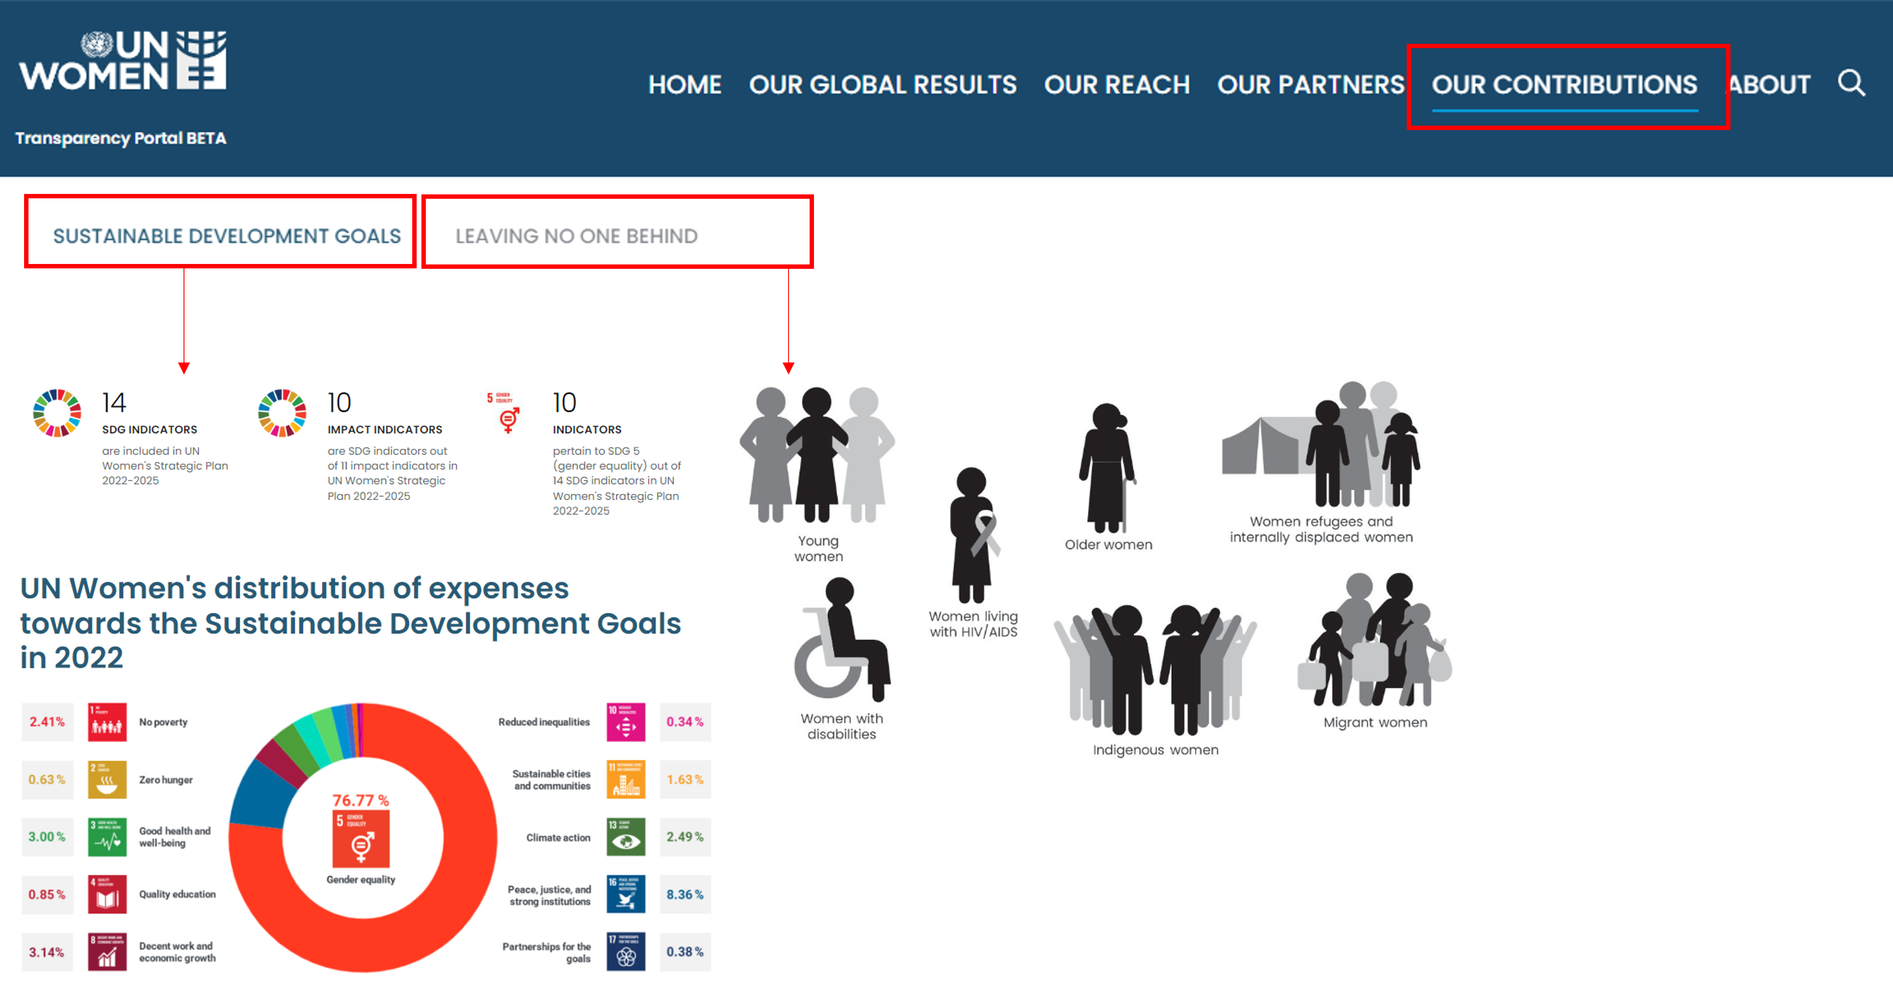
Explore ‘Our contributions’: Expenses across Sustainable Developmental Goals and efforts towards disaggregated Leaving No One Behind data
Link - https://open.unwomen.org/SDGs and https://open.unwomen.org/LNOB

Slide 18
